Slide 1
Private Funds Industry Update: Current Trends in Asset Strategies
Session IV
Speakers:
Edward Dartley, Partner, K&L Gates LLP
Kasey L. Lekander, Partner, K&L Gates LLP
Adam J. Tejeda, Partner, K&L Gates LLP

Slide 2
Current Trends in Private Credit Funds as a Maturing Asset Class

Slide 3
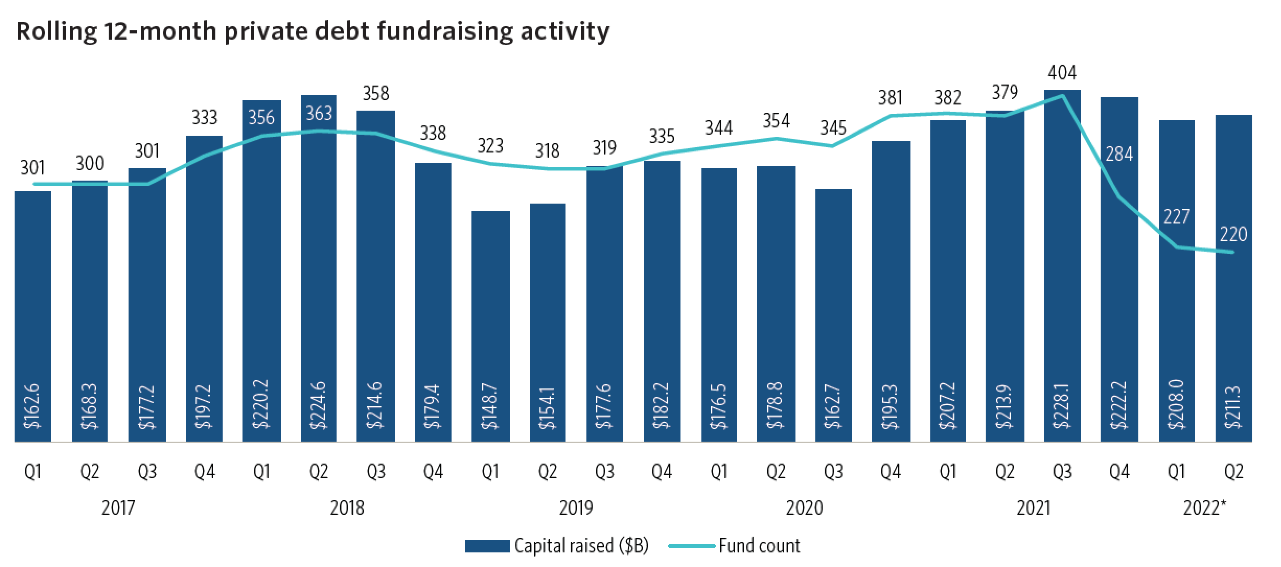
CONTINUED GROWTH OF PRIVATE CREDIT
2021 was a record year for private credit fundraising. 2022 is on pace with 2021, year to date.
Pitchbook, Global Private Debt Report, June 2022

Slide 4
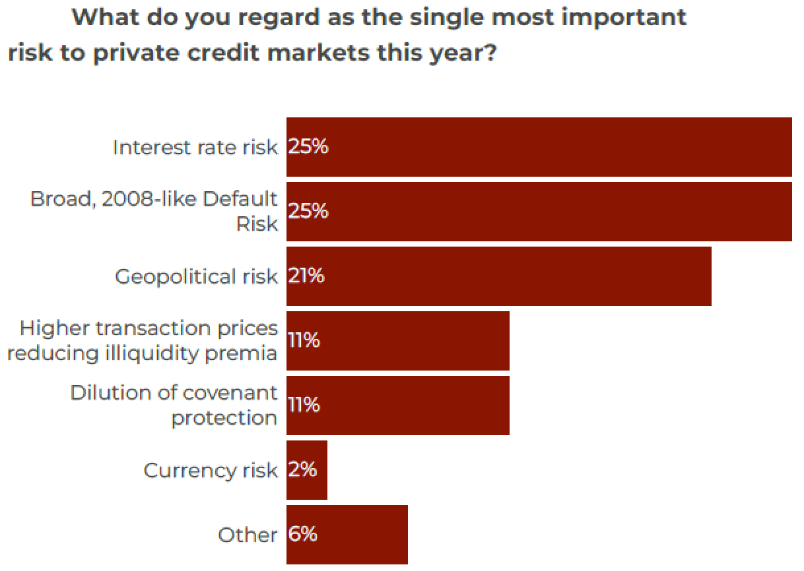
PRIVATE CREDIT – POTENTIAL HEADWINDS
Private Equity Wire, June 2022

Slide 5
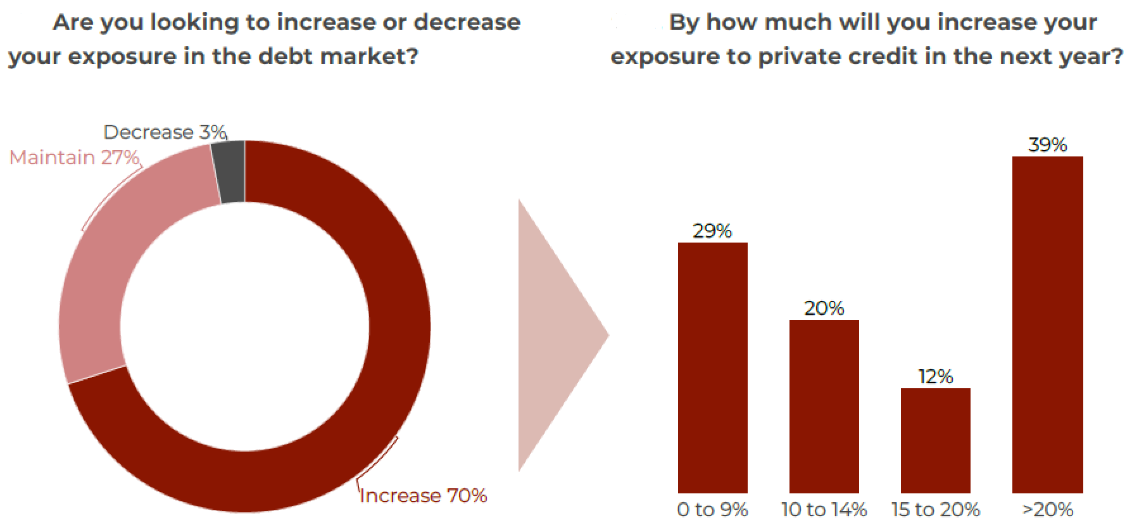
GROWTH – VIEW OF ALLOCATORS

Slide 6
STATE OF THE MARKET - STRATEGIES
Strategies in (ever) greater favor
  Direct lending (including special situations and real estate)
  Venture debt
  Differentiated strategies/ assets
  Private credit with an ESG overlay
Strategies with less near-term momentum
  Leveraged loans
  High yield

Slide 7
STATE OF THE MARKET – FUND SIZE
Fewer “mega” (i.e., >$5B) funds
Greatest market share growth in the $1-5B range
Smaller funds getting market traction often have differentiated strategies or an ESG component

Slide 8
DIRECT LENDING – TAX ISSUES
Tax issues for non-US investors (ECI) from origination activities.
Solutions
  Levered “blockers”
  “Season and sell”
    Insurance dedicated funds as attractive “seasoning” vehicles
  “Captive” financing vehicles

Slide 9
DIRECT LENDING – OTHER ISSUES
State lender licensing, particularly for consumer debt
Higher cost of credit for funds/ potential diminution of arbitrage opportunities

Slide 10
PRIVATE CREDIT – ESG STRATEGIES
Private credit lends itself to a number of ESG strategies
  Utility-scale and consumer solar financing
  Financing of renewable infrastructure/ energy transition
  Funds focused on lending to minority- and women-owned businesses
  Funds focused on financing employee ownership of businesses (ESOP strategies)

Slide 11
LESSONS FROM PUBLIC CREDIT
Success of “green” bonds indicative of ESG interest in debt markets
  59% year-on-year growth from 2020 to 2021, with total global issuance to date of almost $2 trillion
Link, in some green bonds, of interest payable to ESG metrics
  Related emphasis, in ESG-focused private credit funds, on metrics to prove out ESG impact
  Not there yet, but potential linkage of sponsor economics to ESG metrics in ESG-focused private funds

Slide 12
Continuation Funds and Their Evolving Popularity

Slide 13
Background
PE funds are illiquid, closed ended vehicles with fixed offering periods and terms
  LPs generally have limited liquidity, fund life typically 8-12 years
  Fund offering period limited, after which no new LPs admitted (generally first 12 to 18 months)
  Secondaries market provides solutions to some of the barriers of a closed-end structure
    GPs
      Access to new capital for follow-ons
      Extend term/more time to maximize value
      Provide some liquidity/crystallize carry
      Marketing prior to end of fund life
    LP/Sellers
      Liquidity
      Rebalance portfolio
      Buyers
        Ability to diligence portfolio before investing
        Shorter hold periods
        Fund interests typically sell at a discount

Slide 14
Background
Generally started as an LP-initiated market
  Sale of single fund interests
  Often sale of poor performing assets
  Portfolio sales
  • Evolved to GP-led secondary transactions
    Tender of fund interests
    Restructurings
    Top-up funds
    Preferred equity
    Asset level sales
    • Market is currently more than just poor performing assets
      Now often used with cash flow generating/strong performing assets
      GPs may want to continue to hold to maximize value.
      LPs given the opportunity to continue to participate.
      New money comes in to provide liquidity to LPs and provide capital for follow-on investments
      GP maintains control, continues to accrue fees and carry

Slide 15
Background
Asset level transactions are a GP organized process
  LPs generally given option to cash-out or roll into a continuation fund
Various Objectives:
  General Partner:
    Initiate new relationships
    Raise follow-on capital to fund growth
    Continue to earn fees/carry with new and existing LPs/co-investors
    Crystallize accrued carry
  Existing LPs/Co-investors
    Liquidity option through auction process
    Option to continue investment
    Potentially renegotiate fees and carry
  New LPs
    Diligence assets
    Access to high performing assets
  New LPs often secondaries funds or institutional investors
  Customized structures
    While no deal is the same, generally process will require minimum new cash investment, existing LPs can partially or completely exit from an asset, new LPs and rolling LPs participate in a new investment structure

Slide 16
Transaction Overview: General
Applicability
Single asset - Extend holding period for strong or trophy asset
Multi-asset – Carve-out identified assets that may require more time to mature
Strip sale – rebalance portfolio/diversify
Summary
Fund sells all or a portion of a portfolio company to a new continuation fund
LPs able to cash out or roll into new fund
New continuation fund capitalized with new capital and rolling equity
New capital distributed to selling LPs
Sponsor/GP continues to manage
General Benefits
LPs given option for liquidity
Extend term with respect to select investment/maximize value creation
Provides new capital for follow-on investments
May reset sponsor economics
Sponsor able to monetize accrued carry
Recycle capital?

Slide 17
SEC Scrutiny
SEC Proposed Rules (Release No. 5955; February 9, 2022)
Fairness opinion would be required for all GP-led secondaries, must be disclosed to investors
Defined as a transaction initiated by the GP or an adviser. Includes a transfer/sale to continuation fund.
SEC staff has expressed additional concerns
Sponsor has competing duties and interest on the buy-side, sell-side, controls information, potential for misinformation or fraud?
Conflict of interest, limited disclosure about valuation process
The SEC has brought enforcement actions against sponsors relating to the GP-led process

Slide 18
Sponsor Risks
Conflicts of interest and fiduciary duties
  Fairness of valuation
  Disclosure
  On both sides of a deal/able to adequately represent old and new LPs?
How can sponsor mitigate risk?
  Consult LPAC regardless of whether required in fund docs?
  Often works with an investment bank to run a process
  Fairness opinion whether or not required
  Over disclose
  Existing LPs given option and time to decide – common critique is LPs are often not given enough time to make an informed decision whether to roll or sell
    SEC tender offer rules require 20 days
    ILPA recommends 30 days
Advisors Act principal transaction 206(3)?
  Generally if sponsor or its controlling persons own more than 25%

Slide 19
Investor Considerations/Disclosure
Rolling LPs able to participate in the continuation fund on the same or substantially similar terms no less favorable then existing fund terms
  May require parallel vehicle to new investors or separate classes of interests in a single vehicle
Structure tax free for rolling LPs
  In-kind distribution/contribution
Need to consider investor tax profile/need for blockers
  Consider side letters/existing tax covenants under fund documents
Buy-side will want to ensure an arm’s length deal
  Separate counsel for new investors?
  RWI/Indemnification framework
GP carried interest
  Completely crystallized?
  Subject to clawback?
Investor disclosure – description of transaction, rationale for the transaction, information about the financial model, risk factors, transaction related fees, etc.

Slide 20
Terms of the Continuation Fund
Economic and governance terms generally negotiated by the new LPs and rolling LPs/LPAC
Distribution waterfall
  Often more complex than typical waterfall with specific performance hurdles
Additional capital
  Need to address uncalled capital from existing investors, new capital, recycling, ability to make follow-on investments, etc.
Governance – Often a negotiation with new LPs
GP commitment – new cash or roll carry?

Slide 21
Transactional Issues
Similar issues to a third-party sale
  Regulatory, tax structuring, third-party consents, debt financing, etc.
  Need to work with M&A team
Indemnification framework
  Secondary buyers want reps and diligence. Selling fund and LPs often want a clean deal, limited indemnity or just RWI.
Reporting obligations?
  Short-swing trading reporting under Section 16 of the 1934 Act
  MNPI disclosed to LPs and LPAC impact public deals?

Slide 22
Developments in GP Stakes and Seeding Arrangements

Slide 23
overview
Seeding Arrangements Fall Along a Spectrum, with Features Including:
  Making a Significant Capital Commitment to a Fund Manager at the Initial Closing of the Fund
  Assisting with Fund Structuring Issues and Proposing Market Terms and Conditions
  Assisting with Fundraising and LP Introductions
  Providing Financing to the Manager for Startup Costs or Working Capital
  Receiving Certain Economic Benefits in the Initial Fund and in Certain Subsequent Funds

Slide 24
The range of seed and stakes arrangement structures in the current market
Less active “anchor investors” that make a capital commitment at the initial closing and receive fee discounts.
Middle of the spectrum seed investors that make a capital commitment at the initial closing, receive fee discounts and a share of the management fee and carried interest, but have a moderate role following launch.
More active seed investors that make a capital commitment at the initial closing, receive fee discounts and a share of the management fee and carried interest, and have a more active role following launch.
Seed investors that acquire a stake in the general partner.

Slide 25
GP Stakes versus seeding
A GP Stakes investment typically involves some form of minority equity ownership for the seed investor in the fund sponsor’s business
GP Stakes investments are made with both emerging and more mature fund sponsors
By contrast, equity ownership in the fund sponsor is not typically a seeding feature
More recently, lines are blurring as the asset strategy evolves and new players enter the market and investors and managers alike seek more creative arrangements

Slide 26
Developments in seeding arrangements – economicS AND GOVERNANCE
Economic and Governance Rights Can Include:
  The Right to Invest in the Initial Fund and Certain Subsequent Funds on a No-Fee, No-Carry Basis
  The Right to Receive a Share of the Management Fee and Other Income of the Management Company
  The Right to Receive a Share of Carried Interest Payable to the General Partner
  Governance Rights (including LP Advisory Board and Investment Committee Participation as well as Decisionmaking at GP and Manager Level)

Slide 27
Key negotiated terms
Devotion of Time and Key Person Clauses
Change of Control and GP Removal
Fees and Expenses
General Partner Economics
Tax Considerations – Structure, Complexity and Scale
  Structure should not be too complicated, expensive, or administratively burdensome (e.g., debt funds may employ a leveraged blocker structure for non-U.S. investors)
  Real estate needs to balance different investor profiles with a scalable product (e.g., use REITs, blockers, combination of both?)
  Equity funds generally easier structurally from a tax perspective

Slide 28
Developments in seeding arrangements – additional issues
Commitments from Seeding Investors may be Subject to a Sliding Scale or “Ratchet”
Seeding Investors may have the Right to bring in Additional “Introduced Investors” upon Preferential Terms
Seeding Investors may have Put Options, Drag and Tag Rights and other Similar Rights with respect to their Interests in the GP and Manager

