Slide 1
Post-Election Policy Presentation - Washington Update
December 4, 2024
Speakers: Ryan Carney – Government Affairs Advisor, K&L Gates
Scott Gelbman – Government Affairs Advisor, K&L Gates

Slide 2
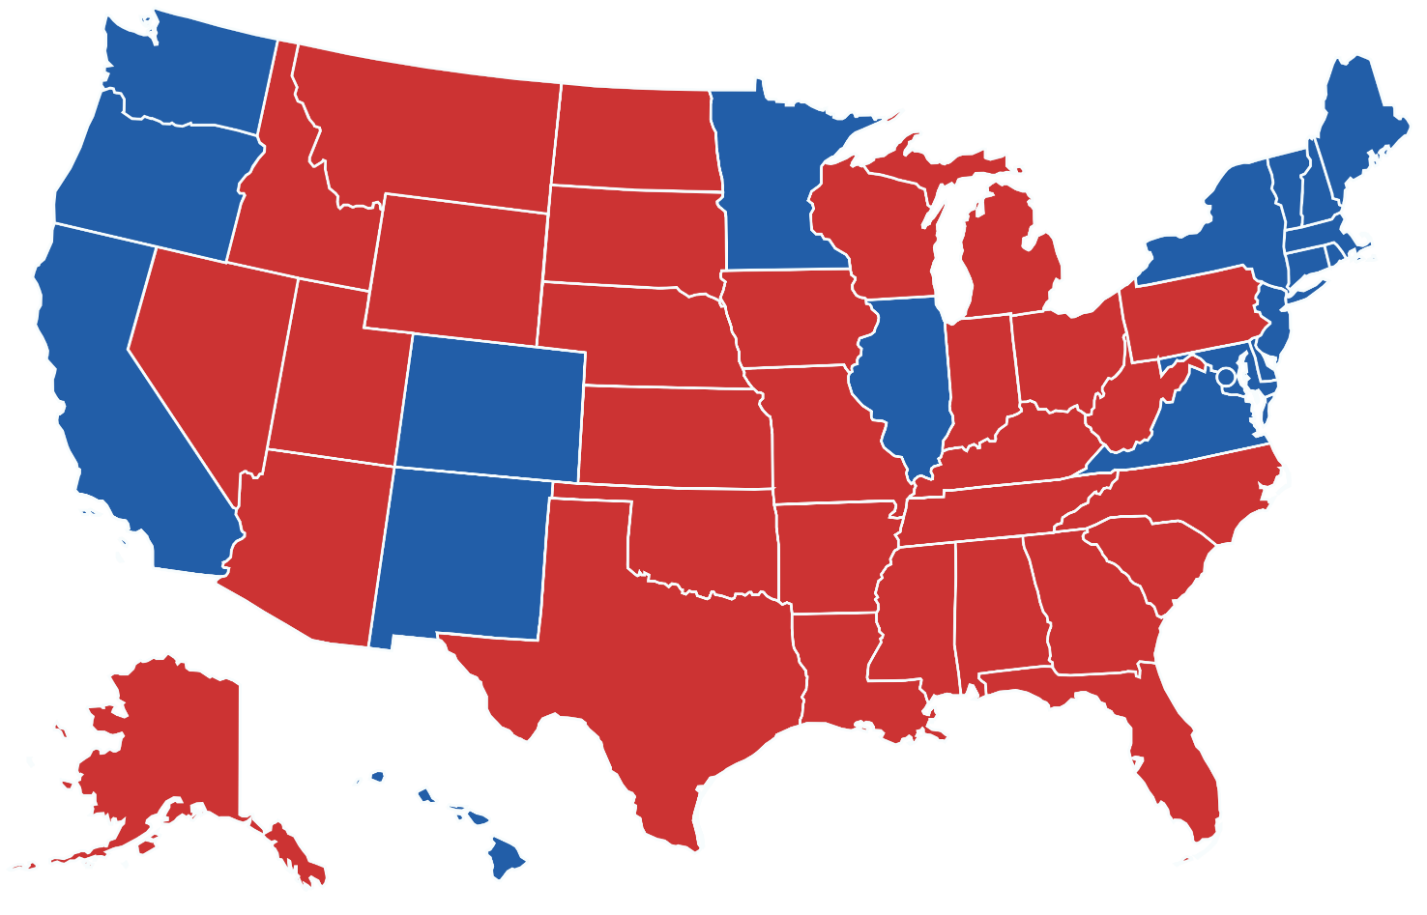

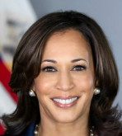
White House: President-elect Trump Wins Decisively
312
76,917,069
(50%)
226
74,441,442
(48%)

Slide 3


119th Congress
HOUSE OF
REPRESENTATIVES
Republican: 220
Democrat: 213
Too Close To Call: 2
SENATE
Republican: 53
Democrat: 45
Independent: 2*
*Caucus with Democrats
Republican
Democrat
Independent
Too close to call/Recount
Source: AP News

Slide 4
The Red Wave
President Trump and Congressional Republicans have a perceived mandate
  Trump improved vs. 2020 in all 50 states
  Election will have consequential policy impacts
Immediate reversal of Biden-era policies (EOs/CRA), fast legislative push, executive/ regulatory/compliance action, oversight, powerful social/traditional media leverage, DOGE
But also, a moment in time: political pendulum swing continues to accelerate; political physics could easily result in a flip in House control in 2026 midterms

Slide 5
The Trump Agenda
Trump won on two primary issues:
  Inflation – appointees will be committed to a pro- economic growth agenda, including “DRILL BABY DRILL” to lower energy costs
  Immigration – focus is on securing the border and deportation of criminal undocumented immigrants.
Trade negotiations will revolve around:
  Tariffs - goal is to address trade imbalances, incentivize American manufacturing, and spurring negotiations on other issues (e.g. NATO)
  Energy - goal is U.S. industry dominance
  China – goal is economic and military isolation

Slide 6
What’s Next
Lame Duck Session Priorities
  Must pass legislation
    FY2025 federal funding
      Timing unclear
    FY2025 NDAA
    Farm Bill
    Debt ceiling
  Senate judicial nominations
  Leadership elections and conference rules

Slide 7

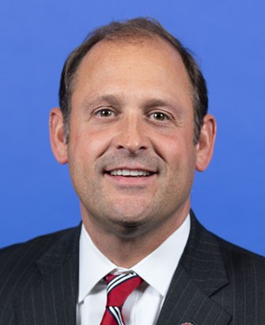



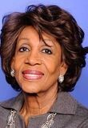
Committee Leadership Changes - HFSC
Patrick McHenry (R-NC), Chairman
  Contenders: Andy Barr (KY),
  French Hill (AR), Frank Lucas (OK),
  and Bill Huizenga (MI)
  Key Priorities:
    Capital formation
    ESG
    Crypto
Maxine Waters (D-CA), Ranking Member
Key Priorities:
    Racial equity and DEI-related efforts
    Oversight of big banks and “bad actors”
    Consumer protection
    Housing affordability and access

Slide 8
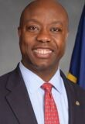

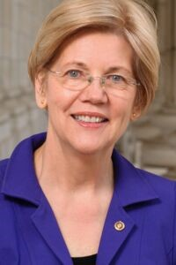
Committee Leadership Changes - Banking
Tim Scott (R-SC), Chair, Banking, Housing & Urban Affairs
  Also likely NRSC Chair
  Key Priorities:
    Capital formation
    Reducing regulatory burdens
    Housing
    Digital assets
Sherrod Brown (D-OH), Banking, Housing, & Urban Affairs
  Defeated in reelection race
  Next most senior member without an existing role as top Democrat on another committee is Sen. Elizabeth Warren (D-MA)

Slide 9
Looking Ahead: Financial Services Policy
Changes in leadership will have changes in policy priorities
Republicans have signaled that a key aspect of their political platform is to undo certain “woke” financial policies implemented by the Biden administration and Democrats, as well as the Basel III Endgame proposal
Top oversight priorities will likely include:
  ESG-related regulations, including countering the “Green New Scam,” proxy voting issues, corporate governance, etc.
  DEI-related regulations and agency initiatives, including human capital disclosures
  International regulatory frameworks affecting U.S. companies (e.g., EU Corporate Sustainability Due Diligence Directive)
  Regulations from the CFPB, SEC, and other financial regulators

Slide 10
However, Slim Margins Remain
Despite Republicans having control of the White House and Congress, slim majority margins will continue to play a role in lawmaking and will necessitate bipartisanship
Some areas of potential bipartisan agreement will likely include:
  China investments
  Digital assets
  Regulation of AI in financial services
  Need for substituted compliance with EU regulatory regime

Slide 11
Impact On ESG Policy
Congress and Trump administration will work together to undo Biden-era regulations on climate, “equity,” etc.
  CRA resolutions, EOs, and rulemaking
EU Sustainability Reporting Regimes
  Will push back on extraterritorial impact of CSRD and CSDDD on US companies
State Laws
  Will seek to preempt state laws (e.g., CA climate laws) if not vacated in court

Slide 12

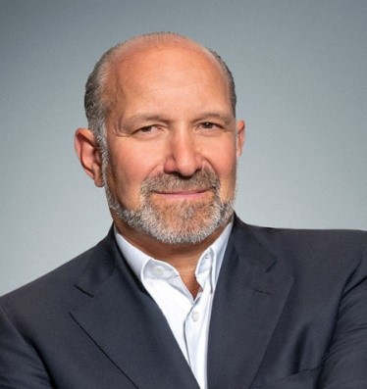
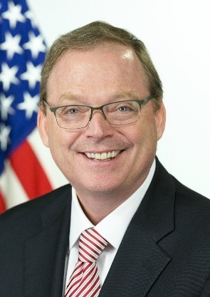

Trump Economic Team
Treasury Secretary
Scott Bessent
Commerce Secretary
Howard Lutnick
NEC
Kevin Hassett
USTR
Jamieson Greer
To Be Announced…
Council of Economic Advisors
SEC Chairman
CFTC Chairman

Slide 13
Trump Administration – Potential Regulatory Impacts
SEC
  Chair Gensler announced he will resign January 20
  Focus on rolling back Biden administration regs, particularly related to:
    Climate risk disclosure
    Proxy advisors
    Shareholder proposals
    Digital assets
CFPB
  Trump plans to remove current Director Chopra
  Elon Musk of DOGE wants to eliminate CFPB
  Focus on reducing regulatory framework

Slide 14
Tax Reform And Related Priorities
2025 Tax Reform
  2017 Tax Cuts and Jobs Act temporary provisions expire
  Trump Administration/GOP Congress want to incentivize US manufacturing, bolster US supply chains and competitiveness
  Big tax bills are few and far between – pent-up Member appetite to consider their pet policies
  Interest in rolling back Biden-era policies, like clean energy
Budget Reconciliation
  Requires only 51 votes in the Senate, not the usual 60
  Budget reconciliation is an arcane process that limits what can be included in it
  Even with only a majority vote requirement, intra-party disagreements, especially over the deficit, could snag the process

Slide 15
What’s Expected In A Tax Package
What won’t be included: Big tax increases on large corporations and the wealthy, e.g., no “billionaire’s tax”
Expect policies to grow the economy, create jobs, bolster US supply chains and competitiveness, deter outsourcing and imports
Chairman Smith priorities are small business, family farms, individuals; will need to meld with more traditional GOP priorities supported by the White House
Keep corporate tax rate low, or reduce further
TCJA extensions
  Extend individual tax cuts
  Extend 199A pass-through deduction
  Restore full expensing, EBITDA base for interest expense, full R&E deductibility
  Extend larger estate tax exemption
  Raising the SALT cap
  Child Tax Credit 2017 doubling
IRA
  Repeal corporate alternative minimum tax
  Repeal stock buy-back excise tax

Slide 16
What’s Expected In A Tax Package
Foreign entity of concern (FEOC)
GILTI, FDII, BEAT reforms
Disaster relief (if not in lame duck)
Taiwan “tax treaty”
Affordable housing
Retaliation against Pillar 2? Digital services taxes?
Offsets
  Expect tension on what needs to be paid for, how much cost needs to be paid for, and adding to the deficit
  Tariffs?
  Proxies for tariffs?
  Repeal or clawing back of IRA clean energy provisions
  Excise tax on endowments
  Build Back Better cutting room floor
  Expect creative surprises
  Don’t underestimate the give and take of policies v. pay-fors

Slide 17
Legislation Is Not The Only Tool In The Box
Congressional Review Act
  Expect the Biden Administration to finalize as many regulations as possible before Jan. 20
  CRA can be used to rescind regulations finalized by a prior administration; majority votes
  CRA window is roughly August 1, 2024 through end of March, 2025
  THE CATCH: Cannot issue “substantially similar” regulations once rescinded. Substantially similar is not defined. Republicans will need to use this tool strategically so they are not throwing the baby out with the bathwater.
Executive Branch
  Trump Administration can reopen regulatory projects
  Can issue sub-regulatory guidance
  Can pause open regulatory and guidance projects
  Can issue executive orders
  Agency appointees
    Policy priorities, resource allocation
The Courts
  Challenges to regulations pursuant to Loper Bright and Chevron deference
  Challenges pursuant to Corner Post

Slide 18
When Do We Expect Tax Legislation?
Republicans are formulating their tax packages now
We may see report-outs from the HWMC Tax Teams on public comments very soon
Republicans will kick-off the budget resolution/budget reconciliation process in January
We may see legislative proposals even before a budget resolution containing budget reconciliation instructions is passed – a marker for policies
GOP hopes to move legislation within first 100 days
  That may be optimistic, depending on tensions between policies and offsets, tolerance for adding to the deficit
Despite optimistic projections, this could drag out

Slide 19
It’s Happening!
Republicans want to deliver for President Trump
Everything potentially is in play
DO NOT ASSUME ANY TAX DEDUCTION, CREDIT, OR ATTRIBUTE IS SAFE
On the other hand, don’t assume an issue is a lost cause and do nothing
Businesses should be modeling the risks and opportunities and engaging
Messaging should be couched in context of the economy, jobs, national security

