Slide 1
Artificial Intelligence for Asset Managers
December 4, 2024
Speakers: Christyn Rossman – Assistant General Counsel, Vanguard
Jennifer Klass – Partner, K&L Gates
Pablo Man – Partner, K&L Gates
Chris Valente – Partner, K&L Gates

Slide 2
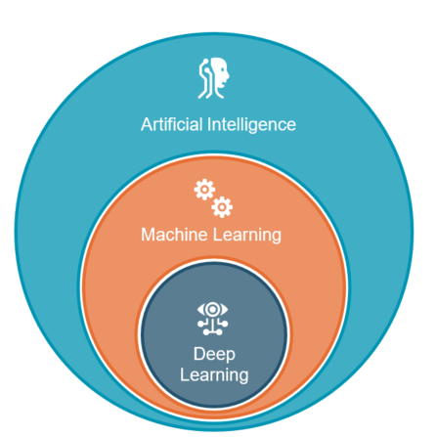
AI vs. Machine Learning vs. Deep Learning
Artificial Intelligence (AI):
A set of techniques aimed at approximating some aspect of human or animal cognition using machines.
Machine Learning (ML):
Machine learning is a type of AI that enables computers to learn from data without being explicitly programmed. It uses mathematical models to analyze data and make predictions or decisions.
Deep Learning (DL):
Deep learning is a subfield of ML that uses neural networks to process and analyze complex data. DL algorithms are capable of undertaking tasks like image and speech recognition, automatically identifying patterns and features within the data.

Slide 3
Examples of Deep Learning
Image and Song Recognition Software
Speech Recognition Software
Natural Language Processing (NLP)
Speech-to-Text Translation
Chatbots
Facial Recognition
Translation Software

Slide 4
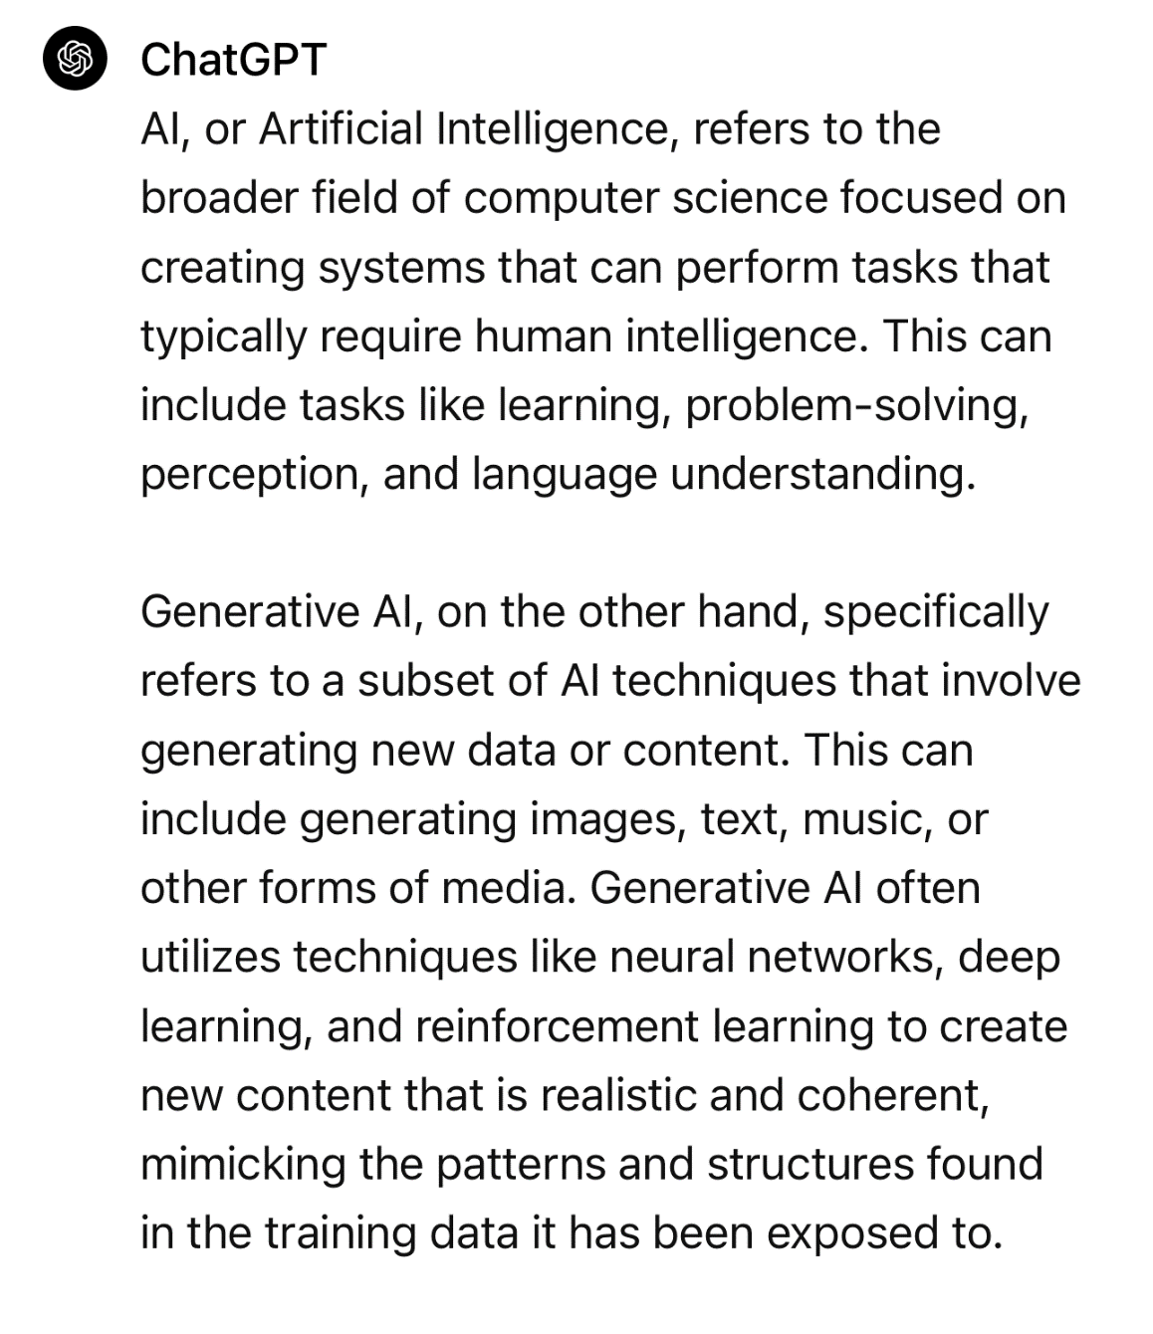

What is the difference between AI and GenAI?
2024

Slide 5
GenAI in Asset Management
Back office administration
Client communications and support
Compliance and risk management
Trade operations
Investment advice and financial planning
Marketing
Portfolio management

Slide 6
Data Related Risks
Confidentiality
Data Quality
AI/ML Attacks
Data Privacy Breach
Testing and Trust
Intellectual Property
Training Data Poisoning
Adversarial Inputs
Accuracy
Bias
Transparency
Compliance
Privacy
Regulatory
Ethics and ESG
User Error
Lack of Expertise
Lack of Supervision
Failure to Understand Capabilities
Categories of GenAI Risk

Slide 7
Actions to Manage Risk
Q: What is your organization currently doing to actively manage the risks around your GenAI implementations?
Establishing a governance framework for the use of GenAI tools/applications
Monitoring regulatory requirements and ensuring compliance
Conducting internal audits and testing of GenAI tools/applications
Training practioners how to recognize and mitigate potential risks
Ensuring a human validates all GenAI created content
Keeping a formal inventory of all GenAI implementations
Using a formal group or board to advise on GenAI-related risks
Using outside vendors to conduct independent audits and testing
Single executive responsible for managing GenAI-related risks
Deloitte’s State of Generative AI in the Enterprise Quarter three report August 2024
deloitte.com/us/state-of-generative-ai

Slide 8
Best Practices for AI Governance
Definition of AI
Governance committee
  AI inventory and prioritization
  Using AI for business purposes
Model risk management
  Data sources
  Review AI models for explainability
  Testing
  Verification of output
Conflicts assessment
Disclosure
  Explanation of risks and limitations
  Form ADV risk factors
Marketing and advertising
Training
Books and records
Service providers and vendor management

