Slide 1
WELCOME
Asset Management and Investment Funds
Fall Conference
12 September 2024

Slide 2
Welcome & Introductory Remarks
Speakers
Mike Caccese – Firm Chairman and Practice Area Leader, K&L Gates
Clair Pagnano – Practice Area Leader, K&L Gates

Slide 3
Private Funds and Alternative Assets
Speakers
TJ Bright – Partner, K&L Gates
Nick Careklas – Managing Director, LongWater
Phil Greenberg – General Manager, Pension Investments (Head of Alternative Assets), U.S. Steel
Kenneth Holston – Partner, K&L Gates

Slide 4
Exploring The Current State of the Registered Fund Industry
Speakers
Clair Pagnano – Practice Area Leader, K&L Gates
Lance Dial – Partner, K&L Gates
Cal Gilmartin – Partner, K&L Gates
Douglas Charton – Chief Legal Officer, GMO Trust and Senior Counsel, GMO

Slide 5
The Names Rule
Expansion of scope applying 80% investment policy requirement to any fund name with terms suggesting the fund focuses in investments that have, or whose issuers have, “particular characteristics”
  “Particular characteristics” are not defined, but will be recognized as any feature, quality, or attribute that suggests an investment focus (e.g., growth, value, ESG)
Enhanced prospectus disclosure to define terms used in a fund’s name
“Antithetical” investments cannot be substantial
Closed-end funds that are not exchange listed will face burdensome requirements when changing names
Form N-PORT reporting marking every investment as in or out of the fund’s “80% basket”

Slide 6
Open-End Fund Liquidity
Form N-PORT will be filed monthly, 30 days after month-end (rather than filing 60 days after quarter-end) and all monthly data will be public
Form N-CEN will require identifying information about liquidity service providers
Liquidity Risk Management Program Guidance:
  Intra-month changes to liquidity classifications
  Meaning of “cash”
  Highly Liquid Investment Minimums
No Swing Pricing or Hard Close, For Now

Slide 7
Technology and Trading
Speakers
Rich Kerr – Partner, K&L Gates
Ryan Louvar – Chief Legal Officer and Head of Business and Legal Affairs, Digital Assets, WisdomTree
Melissa McKay – SVP and Head of Global Markets Legal, State Street
Matt Rogers – Of Counsel, K&L Gates

Slide 8
Regulatory
Speakers
Lance Dial – Partner, K&L Gates
Pamela Grossetti – Partner, K&L Gates
Pablo Man – Partner, K&L Gates
Jamie Peterson – Director, Iron Road

Slide 9
Predictions about U.S. Politics & Policy in 2024
Presented by
Ryan Carney – Government Affairs Advisor, K&L Gates
Joseph Trahern – Of Counsel, K&L Gates

Slide 10

The Polls – TLDR: It’s Really Close!
Average of credible national polls (through 9/11/24)
Harris 48.4%, Trump 47.3%
Average of battleground polls:
Harris 47.9%, Trump 47.7%
Electoral College Today:
Trump 219, Harris 208, TBD 111

Slide 11
The Future of the US Senate
Democrats currently have a 51-49 majority
Joe Manchin from WV retiring, gifting the GOP a 50th seat
Three Dem seats are tossups: MI, MT, OH
Four Dem seats are “Lean D”: AZ, NV, PA, WI
Could a decisive Harris win run the table and protect vulnerable Democrat seats?

Slide 12
The Future of the US House
Republicans currently have a 221-214 majority
Cook Report estimates 208 likely R, 203 likely D seats
Of the 24 tossups, 11 held by Dems, 13 held by GOP
Can vulnerable Republican incumbents win in deep blue states like New York and California with Trump on the ballot?

Slide 13
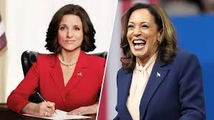
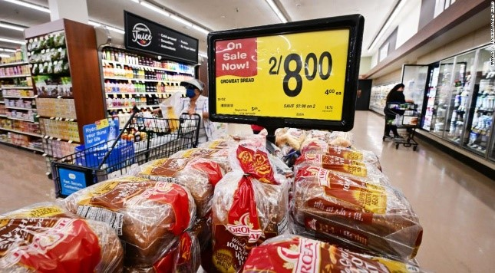




Why Trump will win…

Slide 14

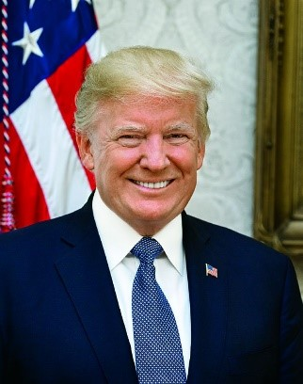



Why Harris will win…

Slide 15

Post Election Predictions

Slide 16
Financial Services Snapshot in 2025
With President Harris, expect…
Continuing Biden priorities at SEC
Expanded focus on ESG, possible Scope 3 rule
Aggressive CFPB
With President Trump, expect…
No Basel III Endgame
Lighter touch from regulators
Pro-crypto policies

Slide 17
Other Things to Consider No Matter Who Wins
The government will still need to be funded
The debt ceiling will still hit on January 2, 2025
AI, China, and the growing debt will still need comprehensive, bipartisan solutions
Most provisions from 2017 tax cuts are still expiring in 2025
  SALT cap, small biz deductions, AMT, estate taxes

Slide 18

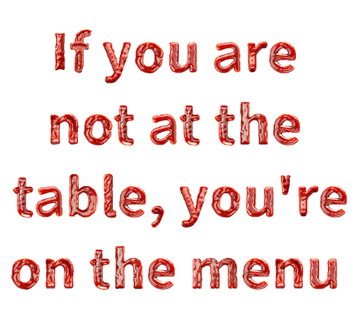
Basic Truth

Slide 19
CLOSING REMARKS
Asset Management and Investment Funds
Fall Conference
12 September 2024

