Slide 1
Understanding How Co-Pay Coupons, Accelerators, and Maximizers Impact Medicaid and Medicare
Pricing and Rebates
November 20, 2025
Andrew Ruskin
Partner
K&L Gates LLP
202.778.9415
andrew.ruskin@klgates.com

Slide 2
Agenda
  Coupon/Accumulator/Maximizer Issues
  Mechanics of copay cards, accumulators, and alternate funding programs
  Implications for government price reporting
  Lawfulness under the Anti-Kickback Statute

Slide 3
Mechanics of copay cards and accumulators

Slide 4
Defining and Exploring Coupons, Accumulators, and Maximizers
Term | Description
Coupons | Copayment offset tools, which cover all or a portion of a beneficiary’s out-of-pocket costs, generally, for a brand-name drug or biologic
Accumulators | Tools health plans, or their PBMs, use to identify beneficiary use of coupons in order to delay a beneficiary’s satisfaction of his/her annual deductible and/or out-of-pocket maximum
Maximizers | Tools health plans, or their PBMs, use on identified specialty drugs or biologics to ensure the maximum value of manufacturer coupon programs is applied evenly throughout the plan year
4

Slide 5
Defining and Exploring Coupons, Accumulators, and Maximizers (cont.)
These programs can take one of several forms:
  The health plan excludes coverage of drugs that have copay cards until the copay card is exhausted, at which time the patient requalifies under an exceptions process
  The health plan coordinates with pharmacies to determine if a copay card was used and, if so, excludes the copay assistance from out-of-pocket (OOP)
  The health plan has the pharmacy call the manufacturer to find out how much benefit is left, and provides no insurance coverage until there is no more copay card coverage
  The health plan excludes coverage for certain specialty drugs and redirects “uninsured patients” to PAP

Slide 6
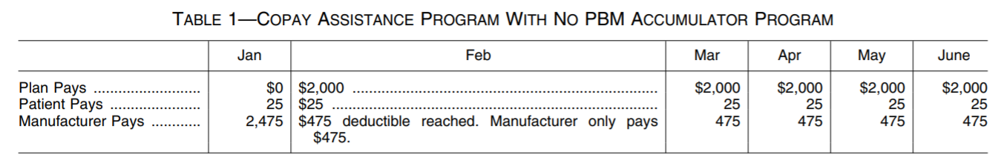
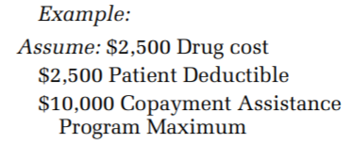
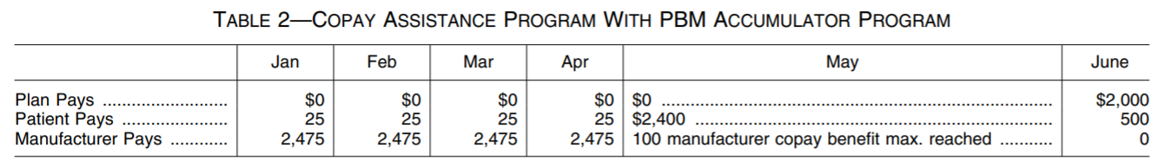
Defining and Exploring Coupons, Accumulators, and Maximizers (cont.)
The situation as explained by CMS in the 2020 MDRP Final Rule:

Slide 7
Defining and Exploring Coupons, Accumulators, and Maximizers (cont.)
If the plan gets it wrong, the beneficiary could have tremendous liability in the middle of the year, possibly resulting in script abandonment
25 states have adopted laws restricting the use of accumulators by PBMs and payors
IQVIA estimates that in 2024 copay assistance totaled $21 billion, of which $7 billion was retained by plans

Slide 8
Defining and Exploring Coupons, Accumulators, and Maximizers (cont.)
Alongside coupons, accumulators, and maximizers, there are alternate funding programs (“AFPs”)
These programs remove coverage for specialty drugs and require patients to enter into manufacturer PAP programs, typically with the assistance of a vendor under contract with the health plan
If the patient receives a PAP denial letter, then the health plan will on an exceptions basis approve the product
Some manufacturers are changing their rules, such that they deny PAP for any patient who is on an AFP, but this is sometimes easier said than done

Slide 9
Defining and Exploring Coupons, Accumulators, and Maximizers (cont.)
For non-grandfathered plans, and eventually for grandfathered plans, these programs based on carve outs will get harder because of agency rulemaking
To carve out a drug, it must be deemed not to be an essential health benefit
CMS in January stated that all drugs that are covered, including those that go beyond the minimum, must be viewed as EHBs
Plans must cover at least one drug for each class or category in the USP, or, if more, they must cover what is required in the State’s benchmark plan
For some drugs, there may be only one or only a couple of drugs in their class or category, making that drug harder to subject to these strategies

Slide 10
Defining and Exploring Coupons, Accumulators, and Maximizers (cont.)
Accumulators on Exchanges
In a 2020 NBPP rulemaking, HHS established a policy for most individual and group health insurance plans that granted health insurers the flexibility to count – or not to count – copay assistance toward an individuals annual limitation on cost-sharing
In August 2022, the HIV and Hepatitis Policy Institute and other patient groups filed suit challenging the NBPP Final Rule. The plaintiffs argued that the CY 2021 NBPP Final Rule conflicts with the definition of cost sharing under both the ACA itself and the ACA’s implementing regulations at 45 CFR 155.20.
On September 29, 2023, the US District Court for the District of Columbia struck down the rule, finding it was arbitrary and capricious to interpret “the same statutory and regulatory provisions as having two different meanings, to be chosen at the discretion of regulated parties.”
Currently, copay assistance must be considered an OOP for the patient only when there is no generic equivalent

Slide 11
Implications of Changes to Part D Benefit (to PAP)
In 2025, maximum out of pocket in Part D is $2000, and there is no donut hole
Can also qualify in some instances for a payment plan with even payments over the course of a year
Some manufacturers, like Pfizer, require enrollment in a payment plan as a prerequisite before consideration of PAP qualification

Slide 12
Implications for government price reporting

Slide 13
Regulations and Guidance on Coupons from 2007 and 2016 MDRP Final Rules
Manufacturer coupons meeting the terms set out in the MDRP regulations are explicitly excluded from Best Price, traditional AMP, and 5i AMP and by extension 340B Ceiling Price and Average Sales Price
2007 and 2016 MDRP Final Rules
Regulation text
“Best price excludes . . . [m]anufacturer coupons to a consumer redeemed by a consumer, agent, pharmacy, or another entity acting on behalf of the manufacturer; but only to the extent that the full value of the coupon is passed on to the consumer, and the pharmacy, agent, or other entity does not receive any price concession.” 42 C.F.R. § § 447.505(c)(9)
13

Slide 14
Regulations and Guidance on Coupons from 2007 and 2016 MDRP Final Rules (cont.)
Boiling it down (the focus at the time):
  Is the coupon not contingent on a purchase requirement?
  Is the value of the coupon not negotiated with a PBM or payor?
  Will a third-party not take a portion of the coupon for its own benefit, beyond a bona fide service fee?
14

Slide 15
Regulations and Guidance on Coupons and Accumulators from 2020 MDRP Final Rule
2020 MDRP Final Rule, effective January 1, 2023
Regulation text
“Best price excludes . . . [m]anufacturer coupons to a consumer redeemed by a consumer, agent, pharmacy, or another entity acting on behalf of the manufacturer; but only to the extent the manufacturer ensures that the full value of the coupon is passed on to the consumer, and the pharmacy, agent, or other entity does not receive any price concession.” 42 C.F.R. § § 447.505(c)(9)
Preamble text
“By not applying the manufacturer assistance to a patient’s deductible or other cost sharing obligations to obtain the drug, the assistance becomes a price concession to the health plan by delaying the point at which the health plan’s contribution toward the patient’s cost sharing begins, or reducing the value of the assistance to the patient, and thus should be counted in best price and, in certain cases, the calculation of the AMP.”
15

Slide 16
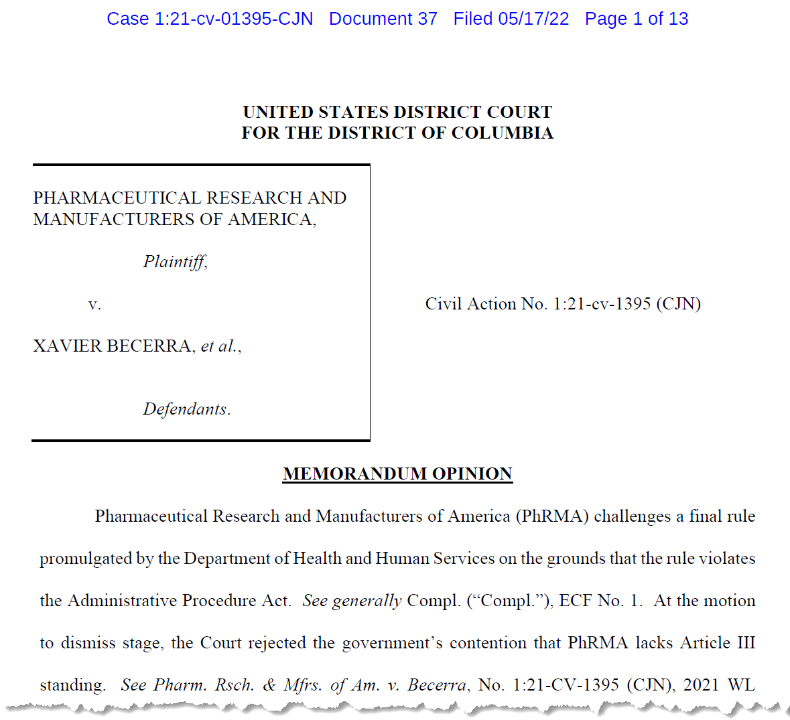
Court Set Aside Accumulator Adjustment Rule
On May 17, 2022, in an opinion granting PhRMA’s motion for summary judgment, the U.S. District Court for the District of Columbia (D.D.C.) ruled in favor of PhRMA and vacated the Accumulator Adjustment Rule.
The court held that the Accumulator Adjustment Rule fails Chevron Step One because CMS lacked the authority to issue the regulation under the text of the MDRP statute.
16

Slide 17
CMS’ 2024 MDRP Rulemaking
On September 20, 2024, CMS finalized a rule that removed the requirement to “ensure” that the patient retain all of the benefit.
Still need to make sure that not giving any sort of price concession to a pharmacy

Slide 18
Lawfulness under the Anti-Kickback Statute

Slide 19
Anti-Kickback Statute
Criminal liability
Includes offering or giving anything of value in exchange for Federal healthcare program business
Requires knowing and willful conduct
There are certain “safe harbors” that protect some types of behavior, but none apply to the issuance of copay cards
An AKS violation can also lead to False Claims Act liability
  Treble damages plus per claim liability over $20K

Slide 20
Co-Pay Card AKS Risks
In 2014, the Department of Health and Human Services Office of Inspector General (OIG) did a review of copay cards
OIG determined that 6 to 7% of Medicare beneficiaries were using copay cards, even though its stated policy is that they violate the AKS when offered to Federal healthcare program beneficiaries
OIG determined that notices on copay cards, websites, etc., to patients and/or pharmacists were not very effective
OIG also noted that using information about the primary payer was not always effective
OIG stated that manufacturers bear the risk of how effective their screening techniques are

Slide 21
Copay Card Available Safeguards
Can do due diligence on website portal
  Instead of asking, “Are you a Federal healthcare program beneficiary?” consider asking discrete questions, such as “Are you and your spouse retirees over the age of 65?”
Can put notice language on card and website, with a box-check approval
Can do a full Benefits Investigation (generally only for specialty pharma)
Can hire a 3PL to administer the copay card program

Slide 22
Claim Adjudication Process
(1) Primary Claim
(1) Primary Claim with
BIN, PCN & Group ID
Primary
Insurance
Company
Rx & Coupon
Dispensed if approved
(2) Patient Copay
(2) Patient Copay
Patient
Retail
Pharmacy
(3) Secondary Claim
(3) Secondary Claim
with Primary BIN
Switch
Program Administrators
(4) Patient Eligibility Approval / Rejection
(4) Patient Eligibility
Approval/Rejection
Pharmacy Claim Adjudication Process:
1 | Pharmacy submits primary claim with patient’s primary insurance to switch. Switch routes claims to primary insurance for approval or rejection.
2 | Primary insurance company determines patient out of pocket copay remaining to switch to send to pharmacy.
3 | Pharmacy submits secondary claim with PSP information to switch. Switch routes to appropriate program administrator.
4 | Program administrator determines patient eligibility (e.g., GPE process), patient out of pocket copay remaining and sends to switch to send to pharmacy.

Slide 23
Types of 3PL Programs
Some use data about the primary payer received over the switch
  Only helpful if pharmacy is using the switch synched with the card
Some use the Benefit State Qualifier field
Some use other algorithms linked to coinsurance amount
Some have a dedicated pharmacy that submits ghost claims

Slide 24
Doing Due Diligence
The AKS has an intent requirement – make sure you ask questions of your vendor
How do you screen out Federal program beneficiaries?
Are you able to screen out Medicaid, as well as Medicare?
Have you ever audited how successful your approach is? Please describe methodology.
Does your technique require that the pharmacy use a specific switch?

Slide 25
Advisory Opinion Route
Manufacturers can also develop a program that does not carve out Federal program beneficiaries and seek an advisory opinion
Pfizer sought an advisory opinion regarding a copay card program for its drug tafamidis
OIG issued AO 20-05 concluding that Pfizer’s making its copay card program accessible to Part D beneficiaries posed more than a minimal risk of fraud and abuse
Pfizer sued in Federal court, claiming that the AKS requires evidence of a “corrupt intent” purportedly not present here
The district and appellate court, however, determined that the statute had no such requirement

Slide 26
Advisory Opinion Route (cont.)
The “Pharmaceutical Coalition for Patient Access” has recently tried to change OIG’s view on copay assistance for Medicare beneficiaries
In Advisory Opinion 22-19 (issued 10/5/22), OIG finally examined a potential use of the “coalition model” that it had first offered in 2005 as a potential pathway forward
However, OIG could not accept the proposed model here, primarily because the manufacturers would only be responsible for subsidizing the costs of their own drugs
OIG found that the arrangement would circumvent the incentives that Congress intended to put in place to increase patient sensitivity to the costs of their drugs
The Coalition subsequently sued OIG in EDVA, but lost on similar grounds as the Pfizer suit

Slide 27
Permissibility of Bridge Programs
Free drug on a trial basis (distributed by manufacturer, and not samples)
  OIG has found certain factors helpful for establishing the acceptability of these arrangements, such as:
    The drug is used only for its labeled indication
    The free drug is for a very narrowly circumscribed time period
    The free drug is only available if a prompt payer coverage decision is not forthcoming
    There are no clinical limitations that preclude converting from the drug to a competitor product
    OIG Advisory Opinions 15-11 and 08-04

Slide 28
Permissibility of Self-Pay Drugs
Cash-paying patients foregoing Part D and receiving a discount
  OIG has said that these arrangements are acceptable so long as:
    Neither the pharmacy nor the patient submits any claims to the payer, and the payment does not count towards TrOOP
    Neither the manufacturer or pharmacy uses the program as a vehicle for marketing other goods or services
    The product has a generic equivalent on the market, meaning that most plans do not include the product on formulary
    Fees to the pharmacy are at FMV

Slide 29
Trump Administration’s Reduction in Self-Pay Drug Costs
Executive Order issued on 5/12/25 provides for, among other things, establishment of MFN for self-pay drugs
On 7/31/25, 17 manufacturers receive letters from Trump Administration demanding, among other things, that they provide MFN pricing to self-pay patients
Pfizer, AstraZeneca, EMD, and Novo Nordisk, and Eli Lilly have announced plans that reduce costs of certain of their products, mostly to self-pay, but, in the case of the GLP-1s, also to Medicare
  Others, such as AZ, carve out Federal program beneficiaries
“Drug discount card” programs are excluded from BP

Slide 30
Permissibility of PAP Foundation Donations
In Advisory Opinion 24-02, OIG deemed acceptable a PAP foundation’s structure, which had disease funds dedicated to rare disorders, each of which was funded by a single manufacturer
OIG looked favorably at the fact that the IRA meant that demand for these funds would now be more limited
It also viewed favorably that the foundation reimbursed for more than drugs
OIG time limited the opinion for two years, as it wanted to consider further the incentives created by the IRA

Slide 31
Buy and Bill Drugs
Generally these are arrangements where the manufacturer allows physicians to process coinsurance support at the physician’s office when administering a drug
  Generally covered under patient’s medical benefit, not pharmacy benefit
  Typically involves a 3PL making direct contact with the payer, meaning that there are generally no Federal healthcare program beneficiaries receiving the support
  But . . . there is a concern with providing an item of value to physicians that “pulls through” the Federal healthcare program business

Slide 32
Buy and Bill Drugs (cont.)
Safeguards to consider:
  Provide a card to the beneficiary, who has to affirmatively present it to the physician
  Only pay the beneficiary upon proof of payment to the physician, and not the physician directly
  Obtain info on the patient’s income status
  Carefully look at the scope of what the coinsurance support applies to

Slide 33
Other Laws
Off-label promotion (?)
State laws
HIPAA

Slide 34


